Slide 1

Course Name: Dummy Variable and ANCOVA Models
Course Duration: 5 Days
Course Resources: Materials + Data + Codes

Slide 2
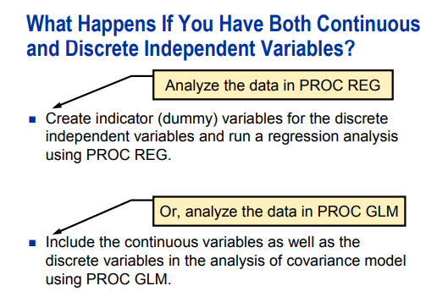
Introduction

Slide 3
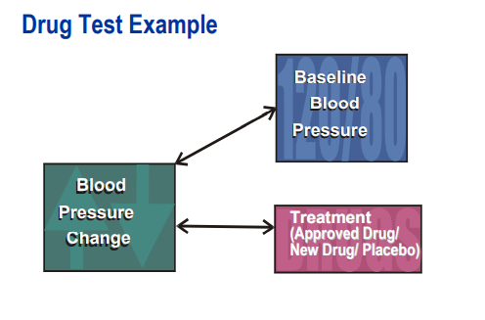
Introduction
Data from clinical trials study was collected to compare the effect of baseline blood pressure values on blood pressure changes after a certain treatment.
Subject: subject ID
Treatment: Drug treatment (Approved Drug, New Drug and Placebo)
BaselineBP: baseline of starting level of diastolic blood pressure
BPChange: Change in the diastolic blood pressure from the beginning of the study

Slide 4
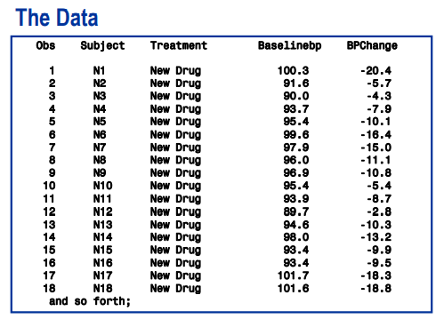
Introduction

Slide 5
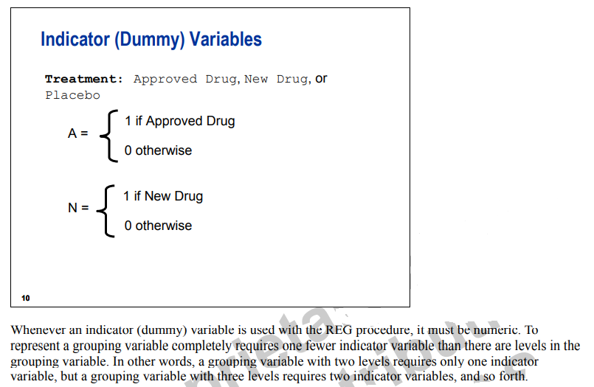
Dummy/Design Variables

Slide 6
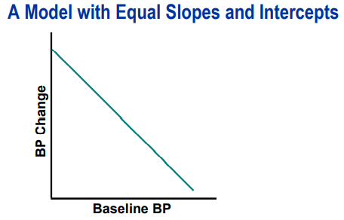
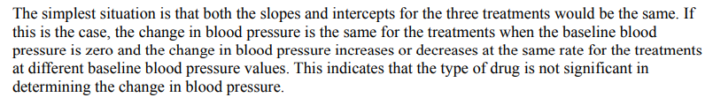
Dummy/Design Variables

Slide 7
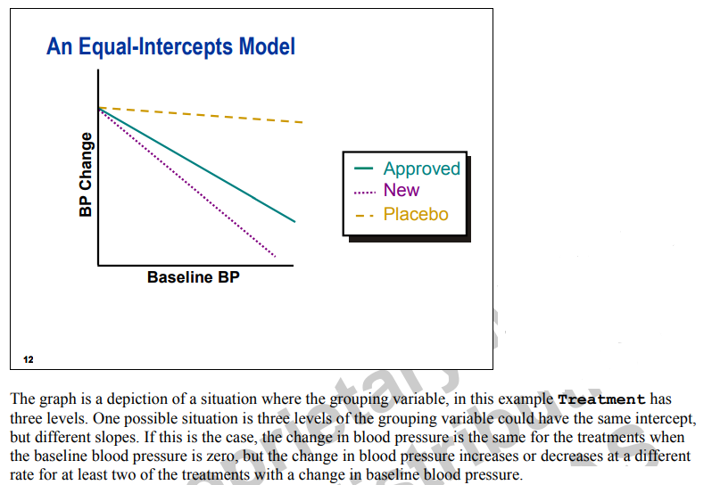
Dummy/Design Variables

Slide 8
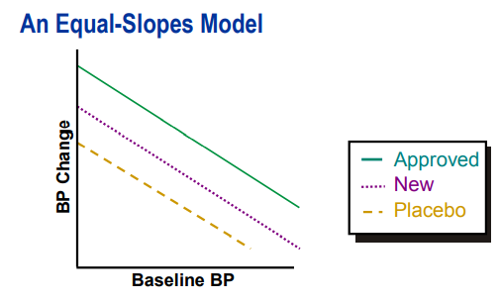

Dummy/Design Variables

Slide 9
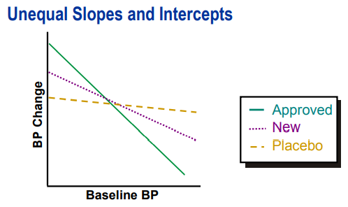
Dummy/Design Variables

Slide 10
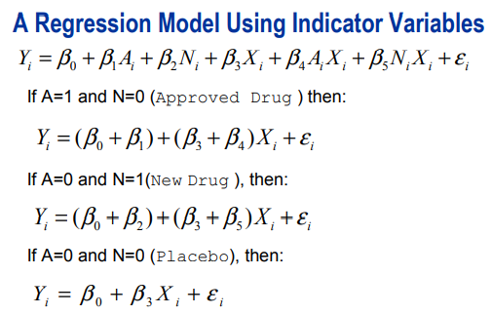
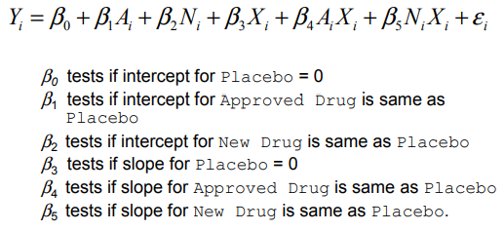
Dummy/Design Variables

Slide 11
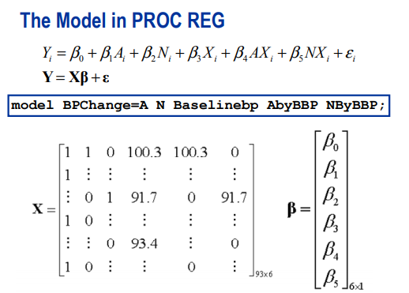
Dummy/Design Variables

Slide 12
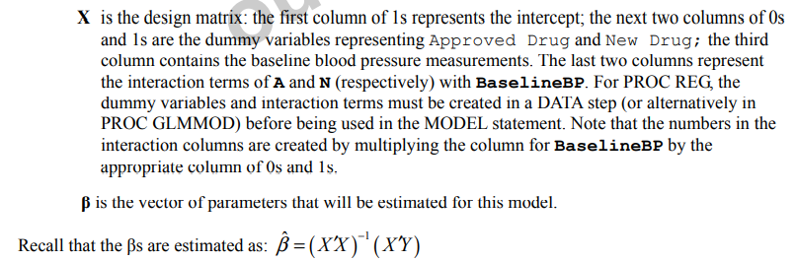
Dummy/Design Variables

Slide 13

DEMO

Slide 14

Dummy/Design Variables

Slide 15
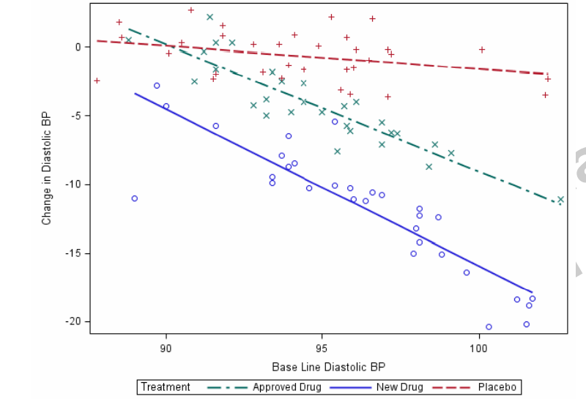
Dummy/Design Variables

Slide 16
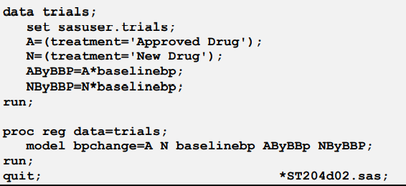
Dummy/Design Variables

Slide 17
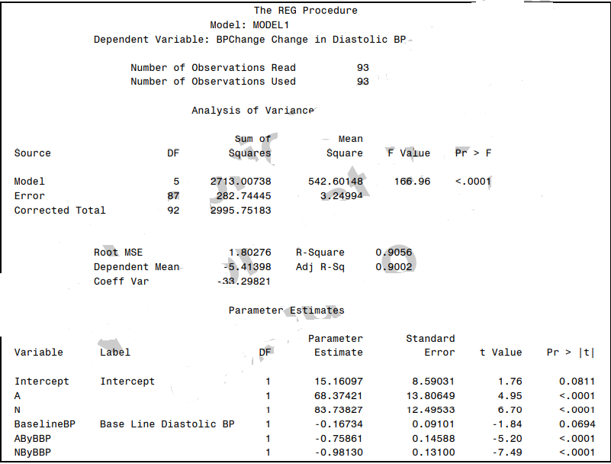
Dummy/Design Variables

Slide 18
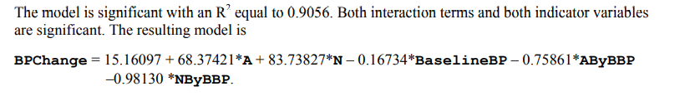
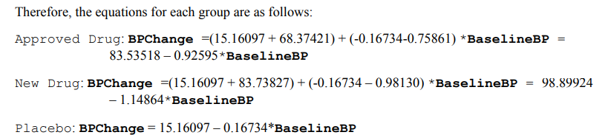
Dummy/Design Variables

Slide 19
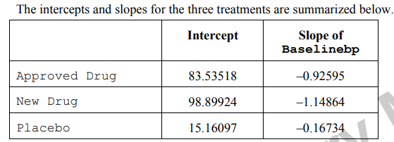
Dummy/Design Variables

Slide 20
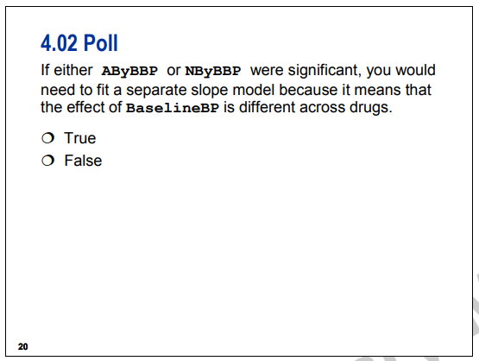
Dummy/Design Variables

